Slide 1
Knapsack Problem

Slide 2
Knapsack Problem
You are given the following-
A knapsack (kind of shoulder bag) with limited weight capacity.
Few items each having some weight and value.

Slide 3
The problem states-
Which items should be placed into the knapsack such that-
The value or profit obtained by putting the items into the knapsack is maximum.
And the weight limit of the knapsack does not exceed.

Slide 4
Fractional Knapsack Problem-
In Fractional Knapsack Problem,
As the name suggests, items are divisible here.
We can even put the fraction of any item into the knapsack if taking the complete item is not possible.
It is solved using Greedy Method.

Slide 5
Fractional Knapsack Problem Using Greedy Method-
Fractional knapsack problem is solved using greedy method in the following steps-
Step-01:
For each item, compute its value / weight ratio.

Slide 6
Fractional Knapsack Problem (Cont..)
Step-02:
Arrange all the items in decreasing order of their value / weight ratio.
Step-03:
Start putting the items into the knapsack beginning from the item with the highest ratio. Put as many items as you can into the knapsack.

Slide 7
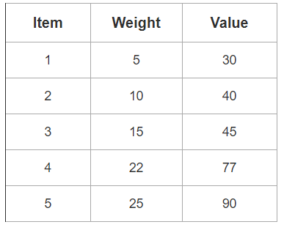
PRACTICE PROBLEM
For the given set of items and knapsack capacity = 60 kg, find the optimal solution for the fractional knapsack problem making use of greedy approach.

Slide 8
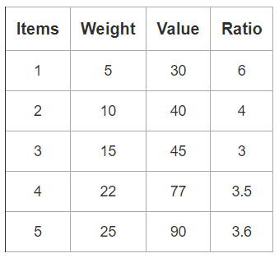
Practice Problem (Cont..)
Step-01:
Compute the value / weight ratio for each item-

Slide 9
Practice Problem (Cont..)
Step-02:
Sort all the items in decreasing order of their value / weight ratio-
I1 I2 I5 I4 I3
(6) (4) (3.6) (3.5) (3)

Slide 10
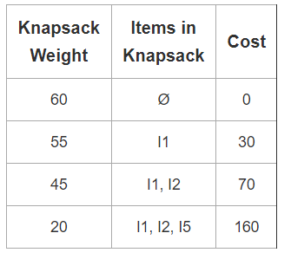
Practice Problem (Cont..)
Step-03:
Start filling the knapsack by putting the items into it one by one.

Slide 11
Practice Problem (Cont..)
Now,
Knapsack weight left to be filled is 20 kg but item-4 has a weight of 22 kg.
Since in fractional knapsack problem, even the fraction of any item can be taken.
So, knapsack will contain the following items-
< I1 , I2 , I5 , (20/22) I4 >

Slide 12
Practice Problem (Cont..)
Total cost of the knapsack
= 160 + (20/27) x 77
= 160 + 70
= 230 units

